Slide 1
STACKS AND QUEUES IN C

Slide 2
Recap on Data Structures:
A data structure is a method used to store data in an organized and efficient manner so that it can easily be accessed for processing.
Data structures can be divided into two main types:
Linear data structures and non-linear data structures.
Examples of linear data structures are arrays, queues, stacks, and linked lists.
Examples of nonlinear data structures are Graphs and trees

Slide 3
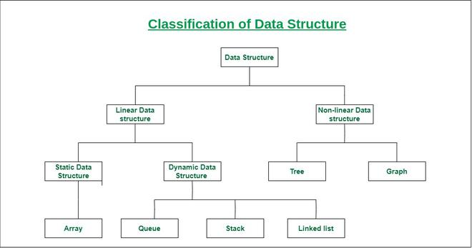

Slide 4
The most common operations that can be performed on data structures include :
  searching,
  sorting,
  inserting,
  updating,
  deletion.

Slide 5
STACKS
A stack is a linear data structure that stores collection of items of the same type.
The method in which data is handled within a stack is known as: “Last In, First Out” (LIFO).
In a stack the operation of inserting an element is known as pushing into the stack and the operation of deleting an element is known as popping out of a stack.
A stack is only open on one end thus the Last element to be pushed into the stack is the First element to be popped out of the stack hence the term last in,first out.

Slide 6
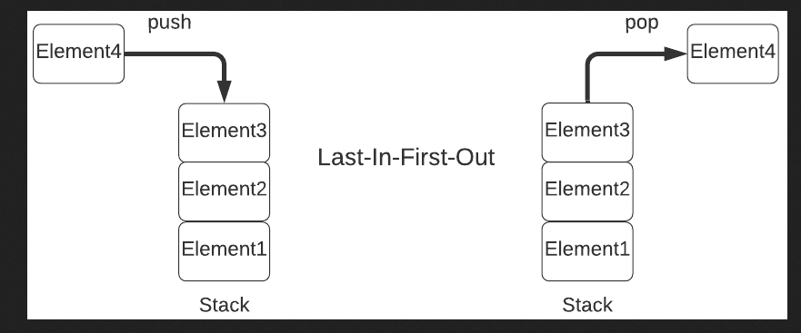

Slide 7
The basic operations done on stacks:
  push: Adds an element to the top of the stack.
  pop: Removes the topmost element from the stack.
  isEmpty: Checks whether the stack is empty.
  isFull: Checks whether the stack is full.
  top: Displays the topmost element of the stack.
If the stack is filled completely then then no elements can be added thus the stack is full. If you attempt to add more data you will get a stack overflow.
If the stack is empty it means we cannot display or delete anything from it.

Slide 8
When implementing your stack in code a basic way to go about it would be :
  Initialize, a pointer (top) is to keep the track of the topmost item in the stack.
  As elements are added or deleted in the stack, the position of top is updated.
  Assuming we have a variable max that indicates the size of our stack thus : When top == max-1, it means that the stack is full
  When top == -1, it indicates that the stack is empty

Slide 9
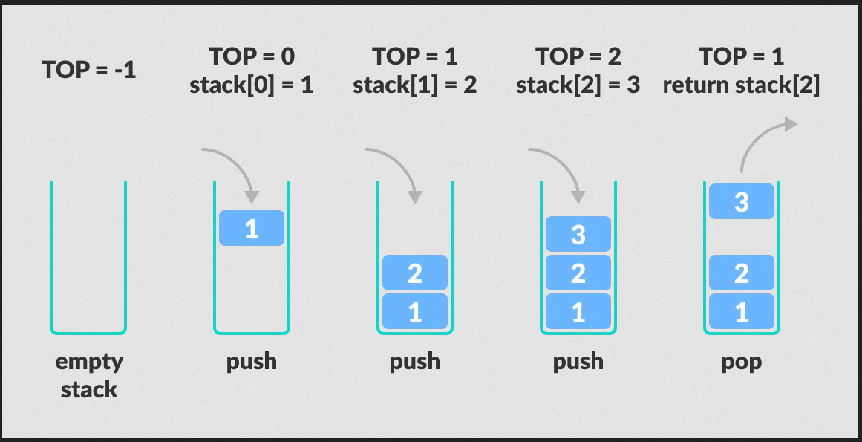

Slide 10
Applications of Stack Data Structure
The most common uses of a stack are:
To reverse a word - Put all the letters in a stack and pop them out. Because of the LIFO order of stack, you will get the letters in reverse order.
In compilers - Compilers use the stack to calculate the value of expressions like 2 + 4 / 5 * (7 - 9) by converting the expression to prefix or postfix form.
In browsers - The back button in a browser saves all the URLs you have visited previously in a stack. Each time you visit a new page, it is added on top of the stack. When you press the back button, the current URL is removed from the stack, and the previous URL is accessed.

Slide 11
Queue
A Queue is a linear data structure that stores collection of items in which data is handled using a method known as: “First In, First Out” (FIFO).
In queues, the first element entered into the queue is the first element to be removed from the queue.
A queue is open on both ends thus insertion is done from the back of the queue and deletion is done from the front of the queue.

Slide 12
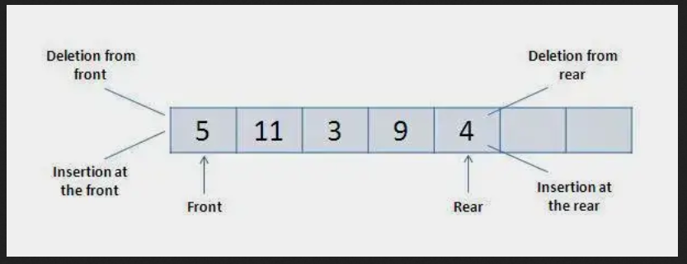

Slide 13
The following operations for manipulation on the data elements:
  isEmpty(): To check if the queue is empty
  isFull(): To check whether the queue is full or not
  dequeue(): Removes the element from the frontal side of the queue
  enqueue(): It inserts elements to the end of the queue
  Front: Pointer element responsible for fetching the first element from the queue
  Rear: Pointer element responsible for fetching the last element from the queue

Slide 14
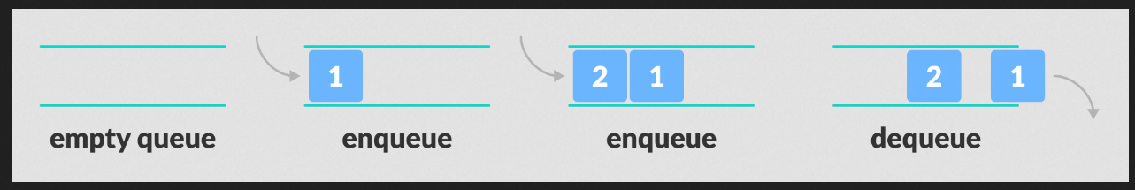

Slide 15
A basic way to implementing your queue would be:
  Initialize a Front and Rear pointer to keep the record of the first and last element in the queue.
  Front = -1 and Rear = -1
  In order to insert an element (enqueue), we need to check whether the queue is full. When rear==max-1, it means that the queue is full.
  In order to remove an element (dequeue) from the queue, we need to check whether the queue is empty. When front== -1, it indicates that the queue is empty.

Slide 16
Applications of Queues
CPU scheduling, Disk Scheduling
When data is transferred asynchronously between two processes.The queue is used for synchronization. For example: IO Buffers, pipes, file IO, etc
Handling of interrupts in real-time systems.
Call Center phone systems use Queues to hold people calling them in order.

